Slide 1
How Much is Bitcoin Worth: Pricing Differences Across Exchanges and Time
Quentin Moore

Slide 2
Motivation
Price Index exists (coindesk.com/price)
Varies across exchanges
Why?
Does this gap change over time?

Slide 3
Area of Focus
Largely USD-BTC focused
Bitstamp.net
Coinbase.com
Localbitcoins.com

Slide 4
Bitstamp & Coinbase
High-Volume Exchanges
Low spread between buy and sell prices
Prices are for immediate buys and sells
Must link bank account
Reduces anonymity

Slide 5
Localbitcoins
User-to-user exchange
“flea market” for bitcoin
Lower volume
Prices vary greatly
Prices are offers by buyers and sellers

Slide 6
The Numbers (Buy Prices)
Bitstamp: $383.62/BTC
Coinbase: $387.22/BTC
Localbitcoins: $393.38/BTC
So why not just only buy from Bitstamp?
Or only sell at Localbitcoins?

Slide 7
Price is affected by…
Payment methods
Most important
Reputation of seller
Convenience to both parties (especially buyer)
Volume of trades
Higher volume = price is closer to an index price

Slide 8
Payment Methods
Cash
Must meet in person
Bank Transfer
Reduces anonymity
Slow, but relatively safe
Paypal
Very risky
Chargebacks…

Slide 9
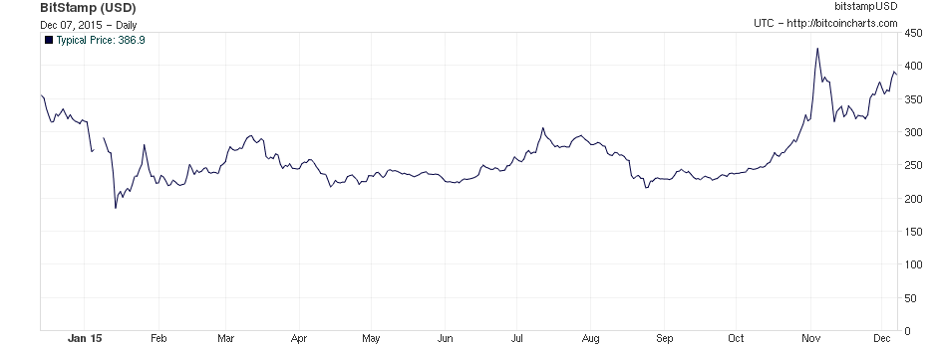
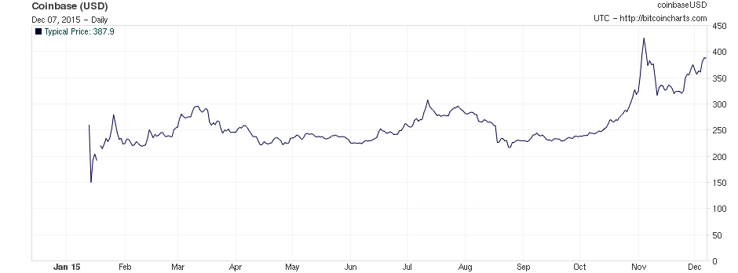
Changes Over Time

Slide 10
Changes Over Time
Localbitcoins has prices that vary too much
Cannot be compared well to the other exchanges

